Slide 1
Review of the 2012 Suomi NPP Applications Workshop: Outcomes, Results, Progress
Forrest Melton
forrest.s.melton@nasa.gov
November 18, 2014
Suomi NPP Applications Workshop, Huntsville, AL

Slide 2
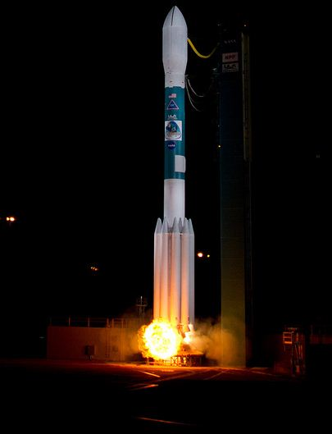
2012 S-NPP Applications Workshop
Meeting Overview
June 21-22, Washington, DC
140 participants from federal agencies, state agencies, universities and non-profits, commercial sector
First Suomi NPP data acquisition on Nov 21, 2011
Feb 22, 2012, Suomi NPP spacecraft transitioned to NOAA for operational control
Suomi National Polar-orbiting Partnership
Launch Site: Vandenberg Air Force Base, Calif.
Launch Date: Oct. 28, 2011, 5:48 a.m. EDT

Slide 3
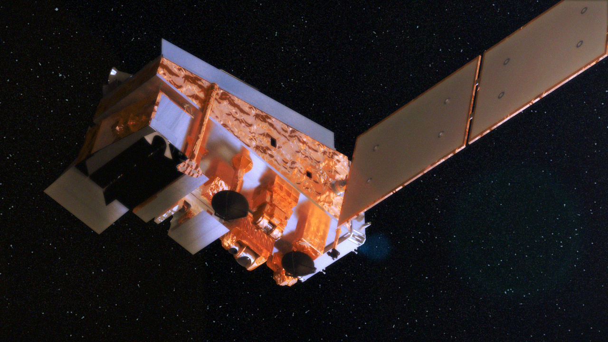
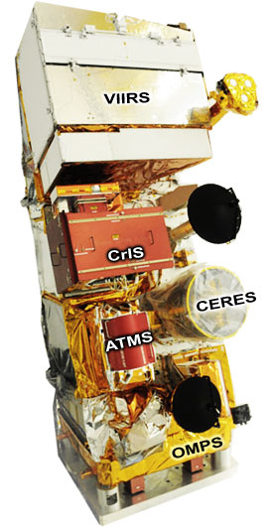
2012 S-NPP Applications Workshop
Meeting Objectives
Update the Earth science and applications communities on the Suomi NPP mission, including, instrument performance, data characteristics, access to data and data products.
Identify and review potential applications of data from all S-NPP instruments, with emphasis on VIIRS.
Provide an opportunity for identification of requirements and community feedback to NASA on data products, data access and other user needs.

Slide 4
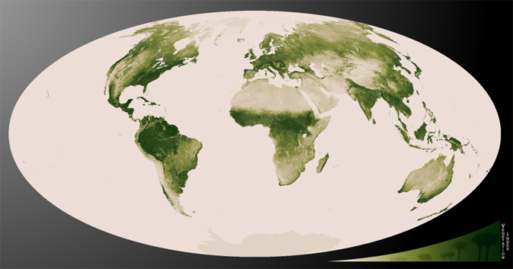
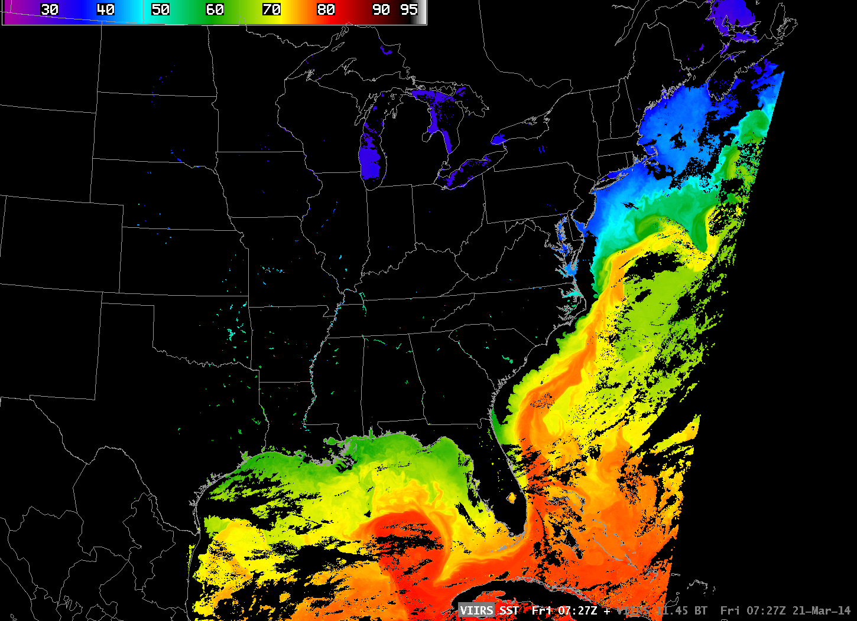
2012 Community Feedback
Data Consistency
EDR / CDR transition from EOS instruments to S-NPP / JPSS → data products must be consistent across the data records from different instruments
EDR / CDR algorithms must be consistent, including handling of QA flags
Necessary differences (algorithm advances or operational needs) should be clearly documented and described
ATBDs should be easily accessible, with clear process for reviewing and commenting on S-NPP ATBDs
VIIRS NDVI Composite, 2012-2013
VIIRS SST, March 21, 2014

Slide 5
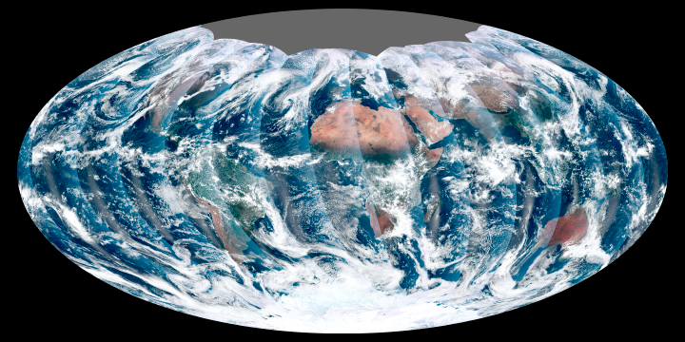
2012 Community Feedback
Data Formats
Many NASA ASP-supported efforts rely on gridded Level 3 EOS data products available from the NASA DAACs or the NASA LANCE system
S-NPP data products must be available as gridded Level 3 products
Available in data formats that are consistent with corresponding EOS data products
Lack of gridded data products will limit the utility of Suomi NPP EDRs and CDRs for the ASP community unless granule/swath to grid tools for S-NPP data products are widely available

Slide 6
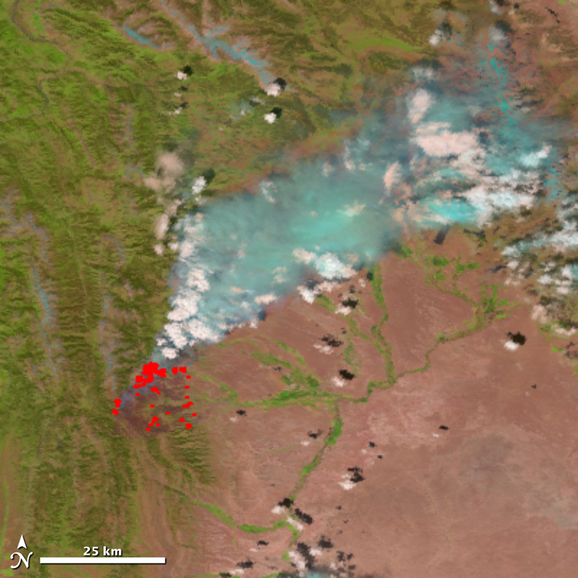
2012 Community Feedback
Data Latency
To support the full range of NASA ASP efforts, S-NPP products must be available in near real-time (available within <12 hours).
Data Reprocessing
To ensure consistency across the S-NPP data record, support for data reprocessing of the full S-NPP data record is required following changes in algorithms, similar to reprocessing that NASA provides for each MODIS collection.
Fontenelle Fire, WY, July 16, 2013

Slide 7
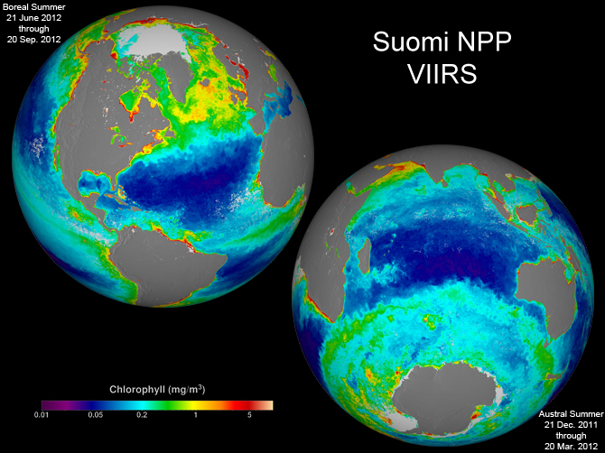
2012 Community Feedback
Data Access
There must a reliable, consistent, easy to use source of data from the S-NPP mission for the NASA ASP community.
User community expressed uncertainty about how to access S-NPP data, and whether to obtain data from CLASS or the NASA PEATEs.
Concern about the potential for distribution of different versions of the same product (generated from the same sensor but using different algorithms) from different data distribution systems (i.e., CLASS versus the PEATEs).
VIIRS Cholorophyll, 2012
Notes:
Product Evaluation and Analysis Tool Element

Slide 8
2012 Community Feedback
Additional Recommendations
To increase interaction with the NASA and NOAA S-NPP / Science Teams, consider a joint meeting with the Applications Community and Science Teams.
Additional information and training on use of CLASS and PEATEs to access S-NPP data, including demos and trainings on data processing, and use and interpretation of QA flags (40% of respondents indicated they would be interested in attending a webinar series on these subjects).
Suomi-NPP Night Lights Composite, 2012

Slide 9
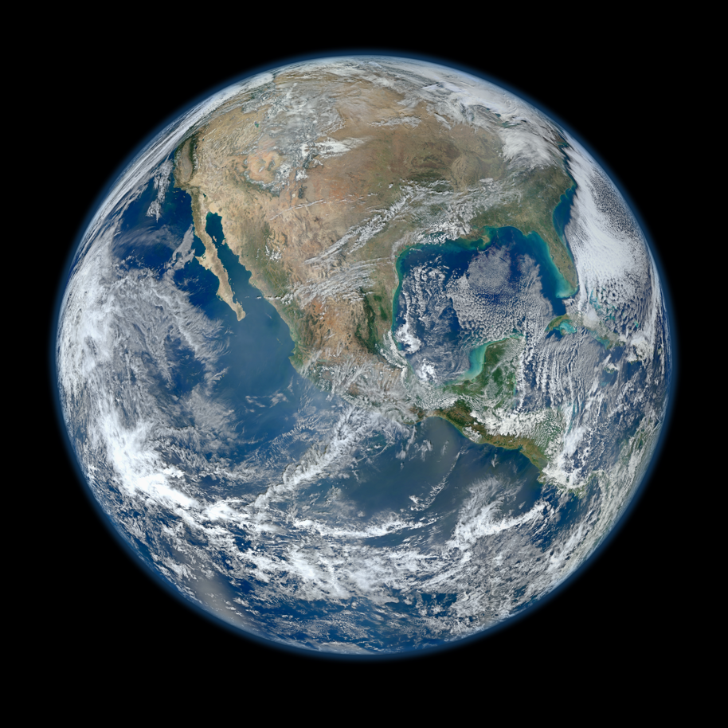
Progress since 2012
Hundreds of publications from S-NPP data
PEATEs w/NOAA ST completed analyses of S-NPP RDRs, SDRs, EDRs, IPs
Beta version of MODIS-compatible data products available from PEATEs → data maturity advancing to ‘provisional’ for many products
Reprocessing support provided by PEATEs
Science Investigator-led Processing Systems (SIPS) established in 2014
Suomi-NPP Blue Marble Composite, 2012
Notes:
NASA is, therefore, planning for an orderly transition from product evaluation and analysis tools to data processing and production systems. This solicitation also requests proposals for the establishment of Science Investigator-led Processing Systems (SIPS) to produce the standard and experimental science data products to be developed by the Suomi NPP ST.

Slide 10
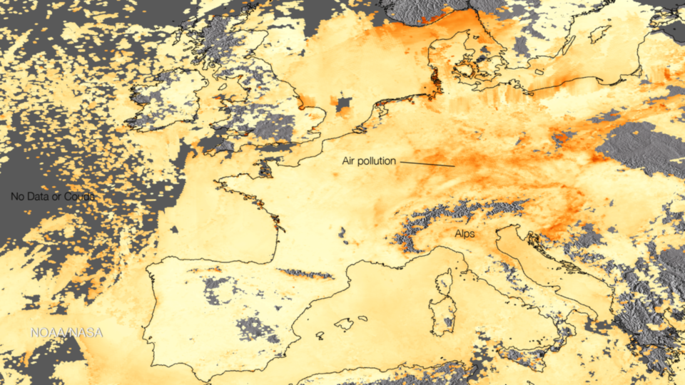
2013 NASA ROSES S-NPP Solicitation
Overview
Develop science quality standard data products using S-NPP measurements that enable continuity of standard Earth system data records from NASA’s EOS Terra, Aqua, and/or Aura satellites
Develop innovative and practical applications of S-NPP data
Develop other new science data products from S-NPP measurements that meet high-priority Earth science needs
NASA S-NPP Science Team
2010-2014: PEATEs → Evaluation of S-NPP RDRs, SDRs, EDRs, IPs
2014-2018: Science Investigator-led Processing Systems (SIPS) → Production of MODIS-compatible S-NPP data products
VIIRS AOT, Europe, Mar 3-9, 2014
Notes:
NASA is, therefore, planning for an orderly transition from product evaluation and analysis tools to data processing and production systems. This solicitation also requests proposals for the establishment of Science Investigator-led Processing Systems (SIPS) to produce the standard and experimental science data products to be developed by the Suomi NPP ST.

Slide 11
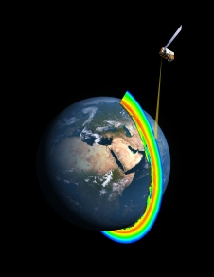
2013 NASA ROSES S-NPP Solicitation
Selections
Five NASA Science Investigator-led Processing Systems (SIPS):
Suomi NPP Land SIPS (Edward Masuoka, GSFC)
Suomi NPP Ocean SIPS (Gene Fedman, GSFC)
Suomi NPP Atmosphere SIPS (Liam Gumley (U. of Wisconsin-Madison)
Suomi NPP Ozone SIPS (Edward Masuoka, GSFC)
Suomi NPP Sounder SIPS (Steve Friedman, JPL)
Forty new ST science investigations across a broad range of disciplines and research questions
NNH13ZDA001N-SNPP Selections:
http://nspires.nasaprs.com/external/solicitations/summary.do?method=init&solId={1261845A-B208-8E8B-38F9-34040759A07A}&path=open
Notes:
NASA is, therefore, planning for an orderly transition from product evaluation and analysis tools to data processing and production systems. This solicitation also requests proposals for the establishment of Science Investigator-led Processing Systems (SIPS) to produce the standard and experimental science data products to be developed by the Suomi NPP ST.
$30 m total over 4 years for SIPS
$29 millions for science team member research
Cloud properties, ozone profiles, water vapor profiles, NH3 (ammonia) and CO profiles, vegetation indices, LAI/FPAR, phenology, nightime lights, ocean color, ocean PAR, cholorphyll a, SST, global burned area, active fires, surface temperature and emissivity, aerosols, surface reflectance, SO2 & NO2
Applications for air quality and agriculture

